Slide 1
Key Findings of the GTED Flagship Report
Official launch of the GTED website
16. 07.2021

Slide 2
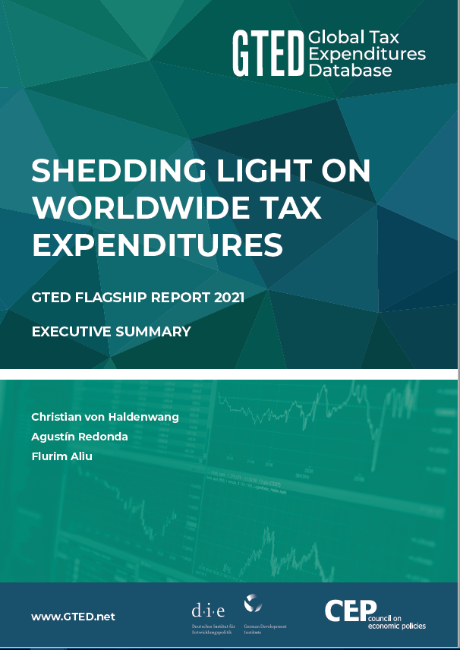
Main messages
Tax expenditures are highly relevant
Upward trend in the total number of governments reporting
Huge variation in the quality of tax expenditure reporting
Richer and poorer countries use tax expenditures differently
The global composition of tax expenditures changes over time
Tax expenditures are important to increase domestic revenue mobilisation

Slide 3
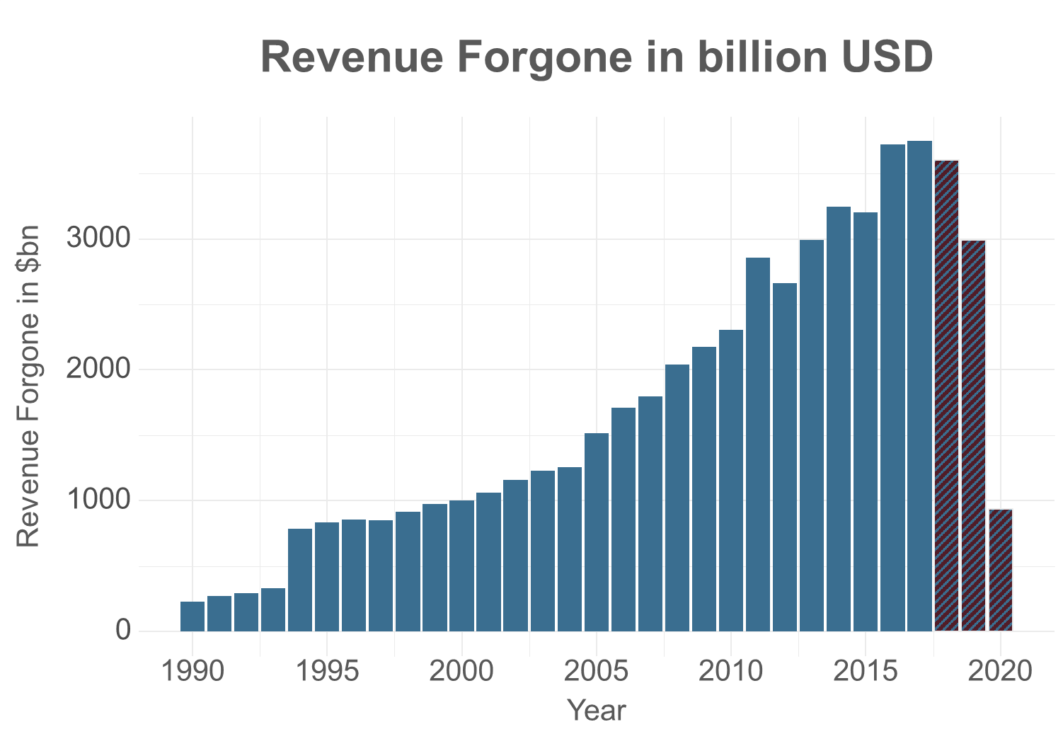
1. Tax expenditures are highly relevant
> 3.5 trillion USD / year in 2016-18
Average: 24.2 per cent
Average: 3.8 per cent

Slide 4
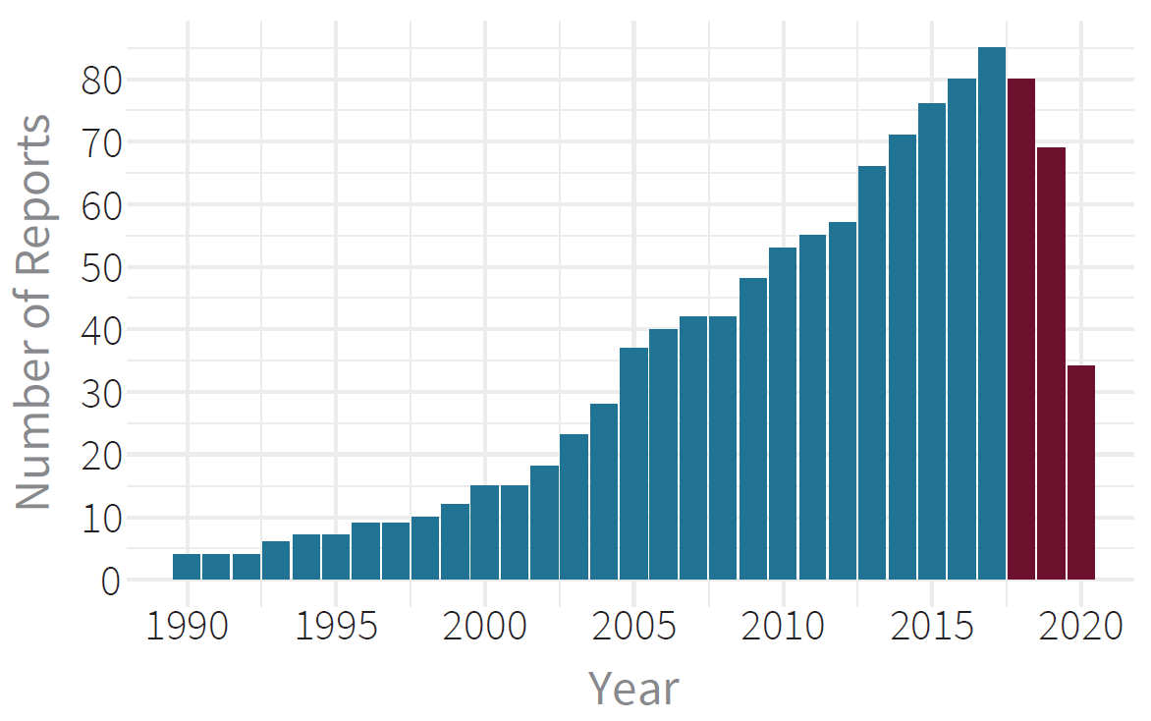
2. Upward trend in reporting

Slide 5
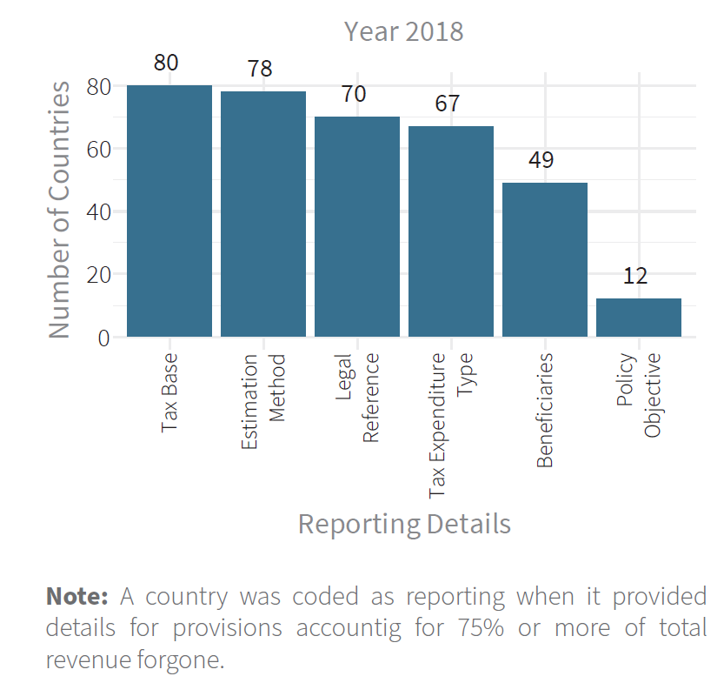
3. Variation in the quality of reporting
42 countries publish reports with provision-level data on a regular basis, most of them members of the OECD or the EU
Of the 46 G20 and OECD countries, 2 do not publish any official tax expenditure information, and 11 only report aggregate estimates
Of the 27 EU member states, 3 do not report on tax expenditures at all, and 10 only provide aggregate information
Of the 79 low- and lower-middle income countries, 45 do not report on tax expenditures and 8 countries report aggregate estimates only.
In 26.1 per cent of all provision-level data entries, no revenue forgone estimates are provided
Note: A country was coded as reporting when it provided
details for provisions accounting for 75% or more of total
revenue forgone

Slide 6
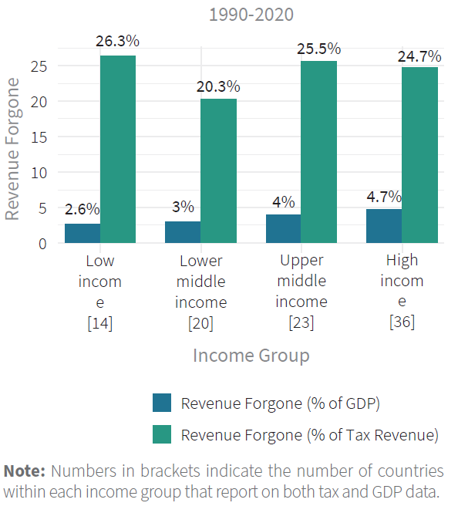
4. Richer and poorer countries use tax expenditures differently
LIC LMIC UMIC HIC
(14) (20) (23) (36)

Slide 7
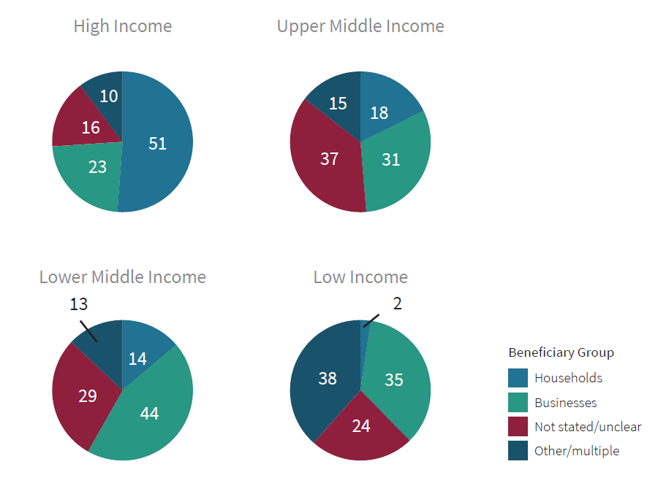
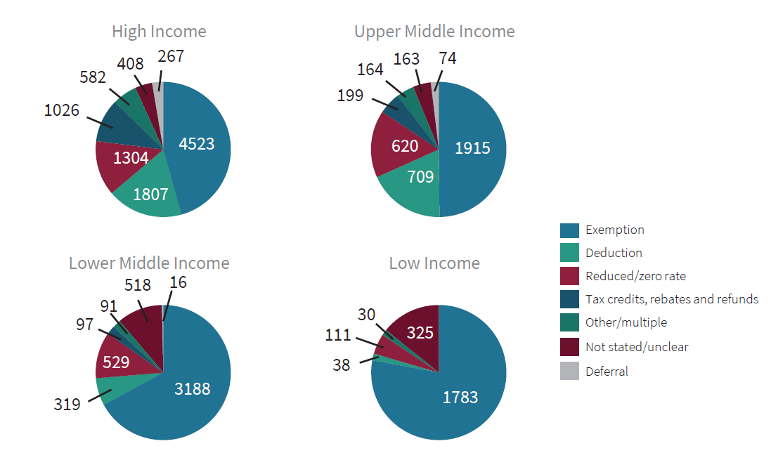
4. Richer and poorer countries use tax expenditures differently
Provisions (per cent / numbers) according to
Beneficiaries
Types of Tax Expenditure

Slide 8
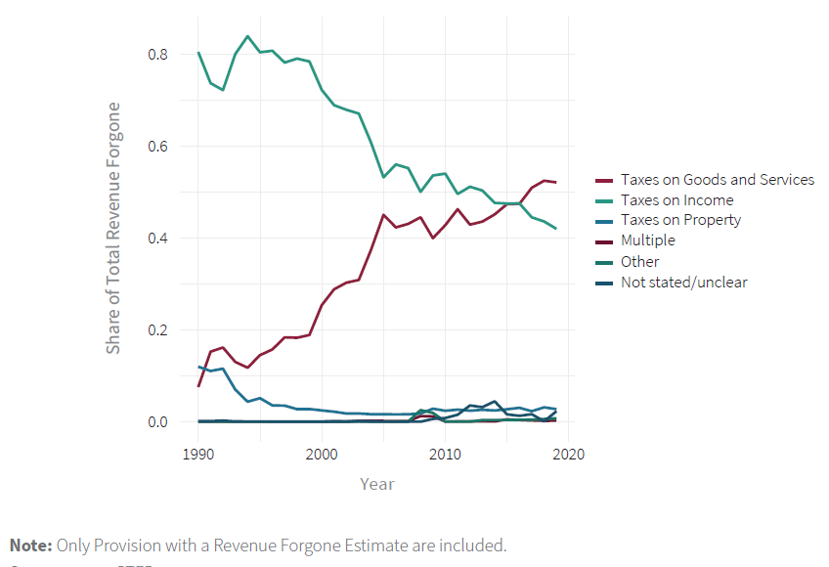
5. Global composition changes over time
Note: Only provisions with revenue forgone estimates are included

Slide 9
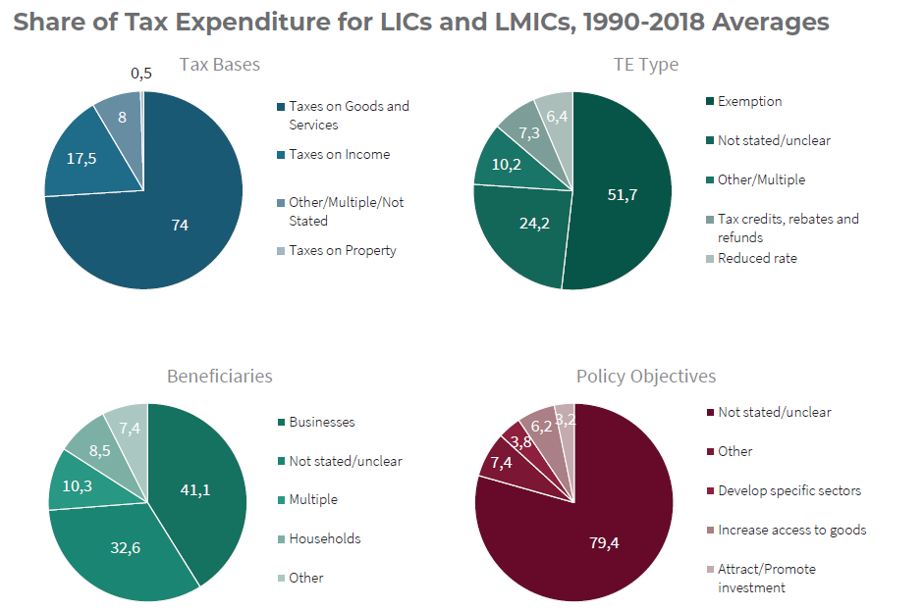
6. Tax expenditures are important to increase domestic revenue mobilisation

